Slide 1
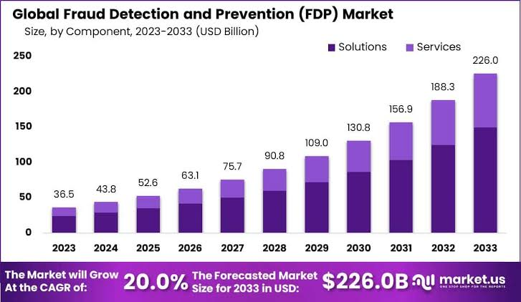
Fraud (anomalies) detection and prevention
One area that machine learning finds important applications is fraud detection. With such large sums of money at stake, it is easy to see why.
According to Statista, the global e-commerce fraud detection and prevention market was estimated at 36.7 billion U.S. dollars in 2021. Forecasts suggest that this figure will continue to grow steadily in the coming years, surpassing the 75 billion dollar mark by 2027.

Slide 2
Fraud detection and prevention
Areas where fraud detection and prevention are applied include insurance claims, money laundering, electronic payments, and bank transactions, both online and offline.
The challenge is to quickly identify and separate anomalous transactions from those that are legitimate, without impacting on customer experience.
Note that companies are also suffering because of lost sales when genuine transactions are declined by fraud management systems.

Slide 3
Fraud detection and prevention
How can Machine learning help?
Before Computer: Banks and financial institutions analyzed their customers’ behavioral patterns for any signs of abnormality, and designed checking rules to “flag” abnormal transactions manually.
After Computer: Computers gave them the ability to identify and flag abnormal transactions in real-time.
After ML: Machine learning tools ‘learn’ new patterns, without the need for human intervention. This allows models to adapt over time to uncover previously unknown patterns or identify new tactics that might be employed by fraudsters.

Slide 4
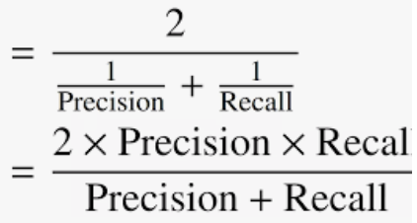
Fraud detection and prevention
Two keys objectives:
(1) High “accuracy”:
high TPR (sensitivity, recall): TP/(TP+FN), equivalently, small number of false negatives
high TFR (specificity): TN/(TN+FP), equivalently, small number of false positives
high precision: TP/(TP+FP)
F1-score

Slide 5
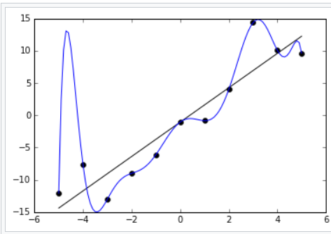
Fraud detection and prevention
(2) Avoid overfitting
We build the ML model based on some training dataset, which has many noises and outliers.
An overly complex model may have very high accuracy for this training dataset, but very low accuracy in general.
A simple example of overfitting:
Suppose the data points are all on the black straight line,
but the training data points we used to build our model
do not fall on the line because of noises. Our trained
model (blue line) has serious overfitting problem:
‘fit’ extremely well for our training data, but
has very low accuracy in general (e.g., when x = -4.5,
the correct label should be -13, but the model
predicts 14..

Slide 6
Fraud detection and prevention
Choose the right model:
There are many good free ML learning tools available (e.g., from scikit-learn, TensorFlow)
These tools have their own strengths and weaknesses.
We need try a number of different model building algorithms, fine-tune their hyper-parameters so as to pick the right tool with good hyper-parameters for our application ➔ high “accuracy”, avoid overfitting (i.e., the complexity of the model is just right).

Slide 7
An example on ML fault prevention: Money Laundering
The problem is difficult because
the offenders are legitimate users too,
just detect and give a ‘red flag’ for an abnormal transaction that has already happened may not help much; the user may have fled by the time the fraud is detected.
We need to detect and prevent abnormal transactions from happening in real time.
We can use ML to learn those common characteristics (patterns) of the fraud transactions from money launderers and other hackers
For any new transaction, our machine learning tool detects these patterns automatically, and to alert us (e.g., tagging it with Redflag) immediately when it detects abnormal transactions.

Slide 8
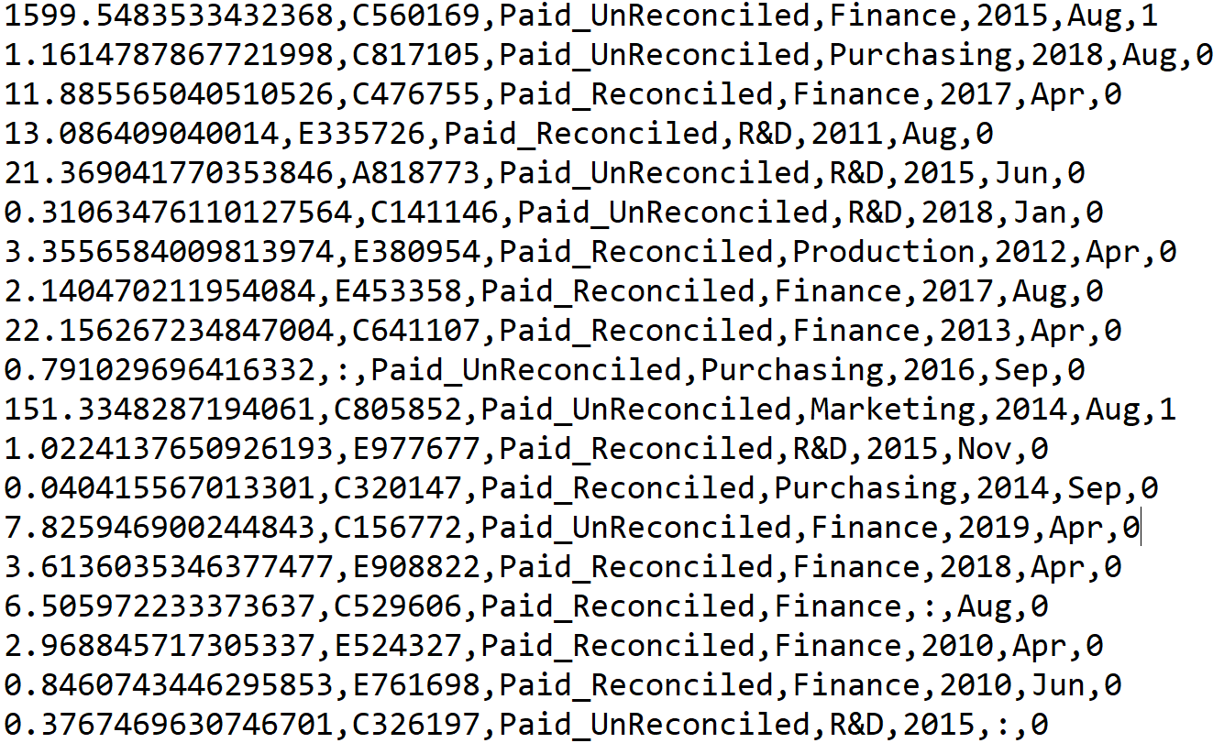
The dataset
Based on the following transaction file: tranrecords.csv
The csv is for the “comma-separated-values” format

Slide 9
The dataset
Based on the following transaction file: tranrecords.csv
The csv if for the “comma-separated-values” format
Missing value

Slide 10
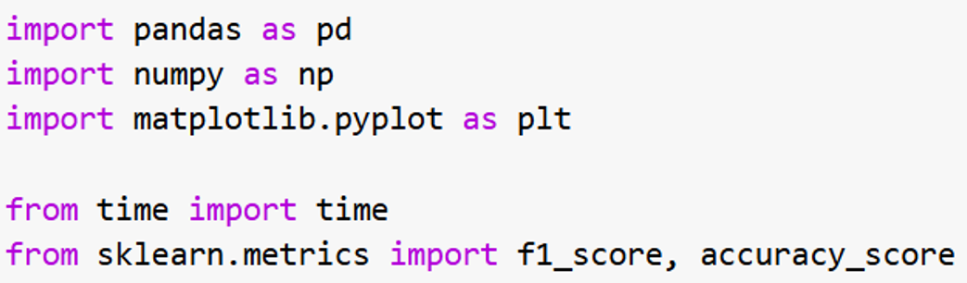
Libraries to be imported

Slide 11
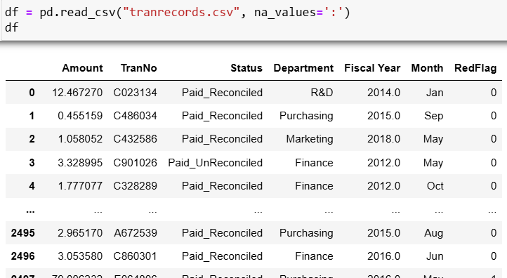
pandas has a simple method for reading cvs file

Slide 12
pandas has a simple method for reading cvs file
‘:’ represents
missing values
(not-available
values)

Slide 13

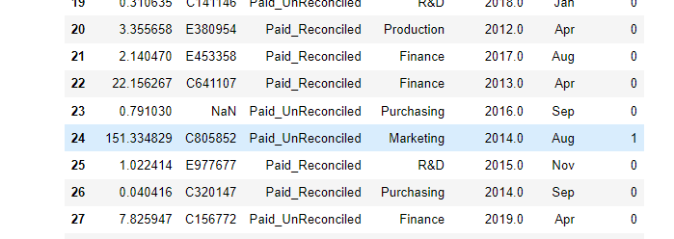
What’s happened? Replace all ‘:’ by NaN

Slide 14
What’s happened? Replace all ‘:’ by NaN
Why do we need to convert
‘:’ to Nan?
Because:
Pandas has many useful
methods for us to detect
and handle these NaN
values.
More details later.

Slide 15
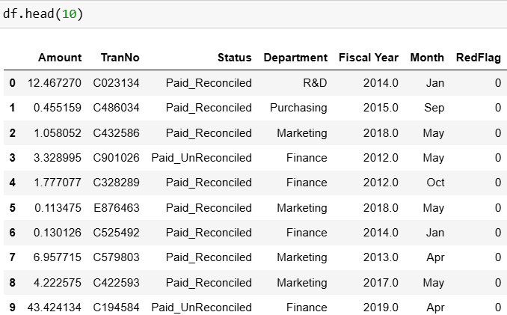
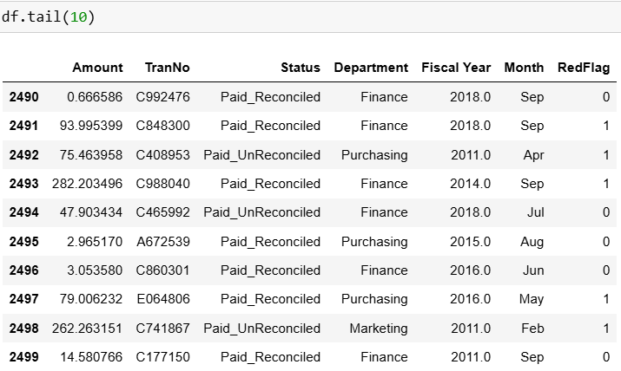
Know your data and clean your data
Look at the “first” and “tail” of the data frame
…

Slide 16
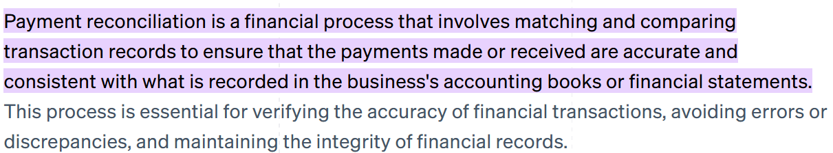
Know your data and clean your data
Look at the “first” and “tail” of the data frame
…

Slide 17
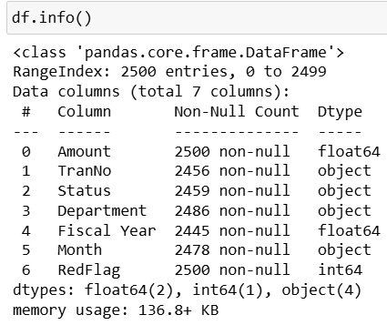
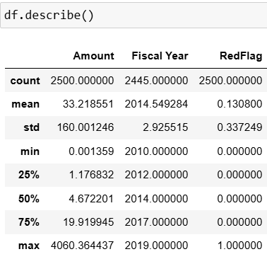
Know your data and clean your data
Have some summaries of your data:
i.e., not NaN values

Slide 18
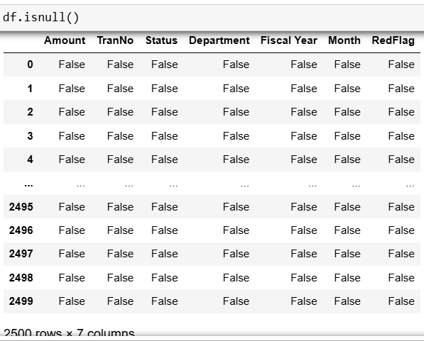
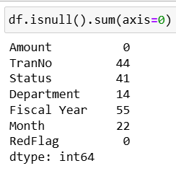
Know your data and clean your data
Find the number of NaN values in every column:
sum along the
row indices

Slide 19
Know your data and clean your data
Before further exploring your data, we need to handle these NaN values first.
For numerical data, we can replace the Nan values by the mean of “normal” values in that column

Slide 20
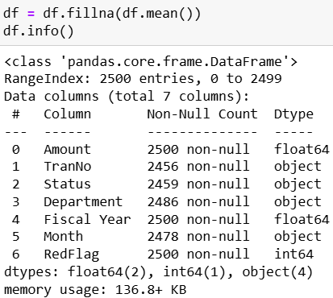
Know your data and clean your data
To find the mean of each (numeric) columns: df.mean()
To replace the Nan values by this mean: df.fillna(df.mean())
object values have no mean,
thus there are still NaN values
in these columns

Slide 21
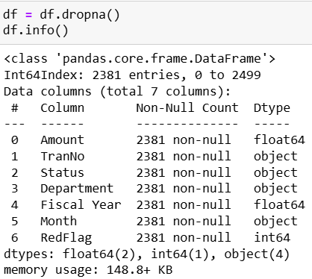
Know your data and clean your data
To drop (i.e., delete) all the rows with Nan values in df:

Slide 22
Know your data and clean your data
Some better method for handling Nan_values:
Using sklearn’s class SimpleImputer

Slide 23
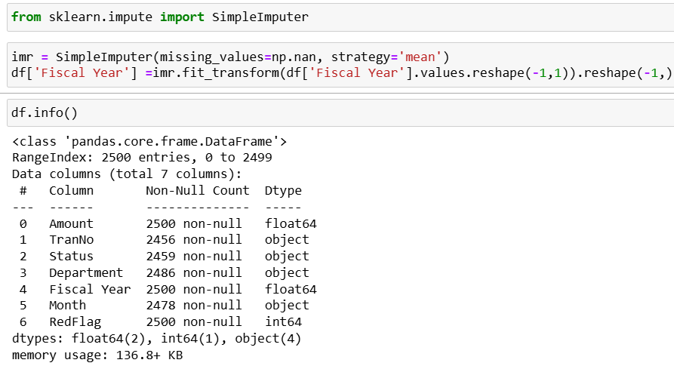
Know your data and clean your data
Using sklearn’s class SimpleImputer
For numeric columns: We find from df.info() that only the column ‘Fiscal Year’ has Nan-value.

Slide 24
Know your data and clean your data
Using sklearn’s class SimpleImputer
For numeric columns: We find from df.info() that only the column ‘Fiscal Year’ has Nan-value.
Note that this df is the original one,
not df we got after calling fillna() &
dropna() in the previous two slides.

Slide 25
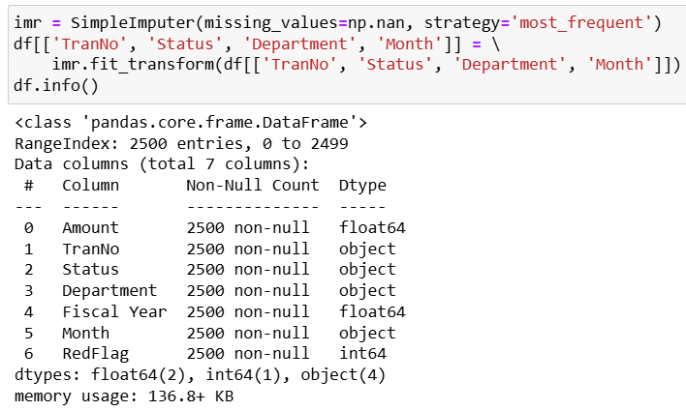
Know your data and clean your data
For “object” columns

Slide 26
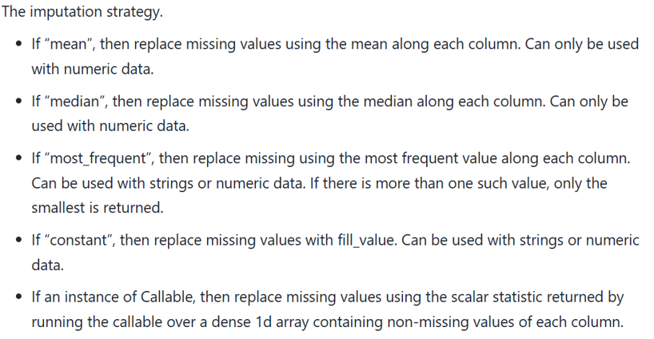
Know your data and clean your data
SimpleImputer() has other strategies:

Slide 27
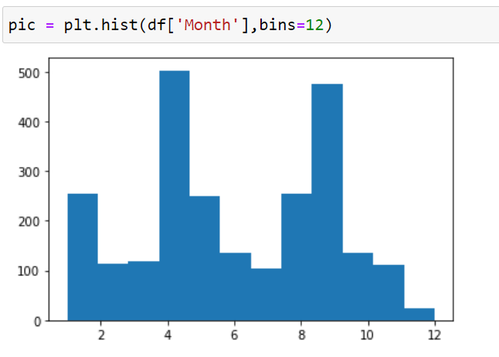
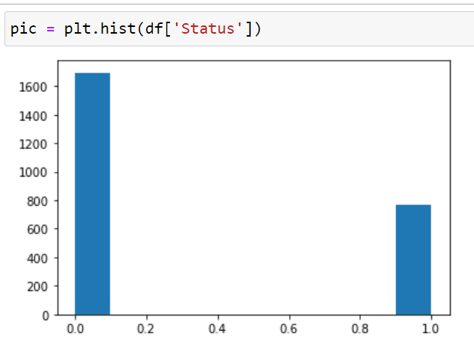
Know your data: distributions of data

Slide 28
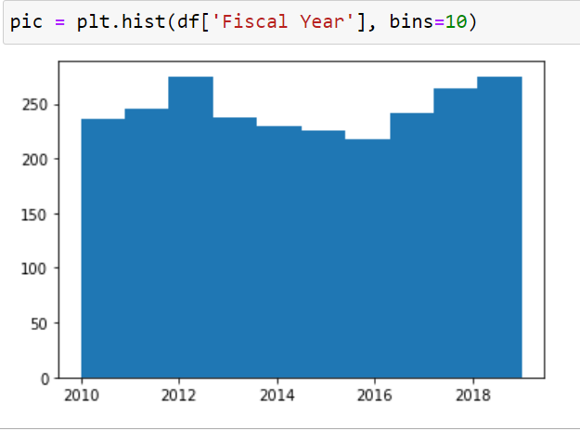
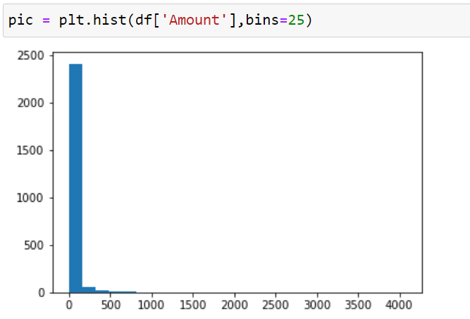
Know your data set: distributions of data

Slide 29
Know your data set: distributions of data
Not normal.
Why?

Slide 30

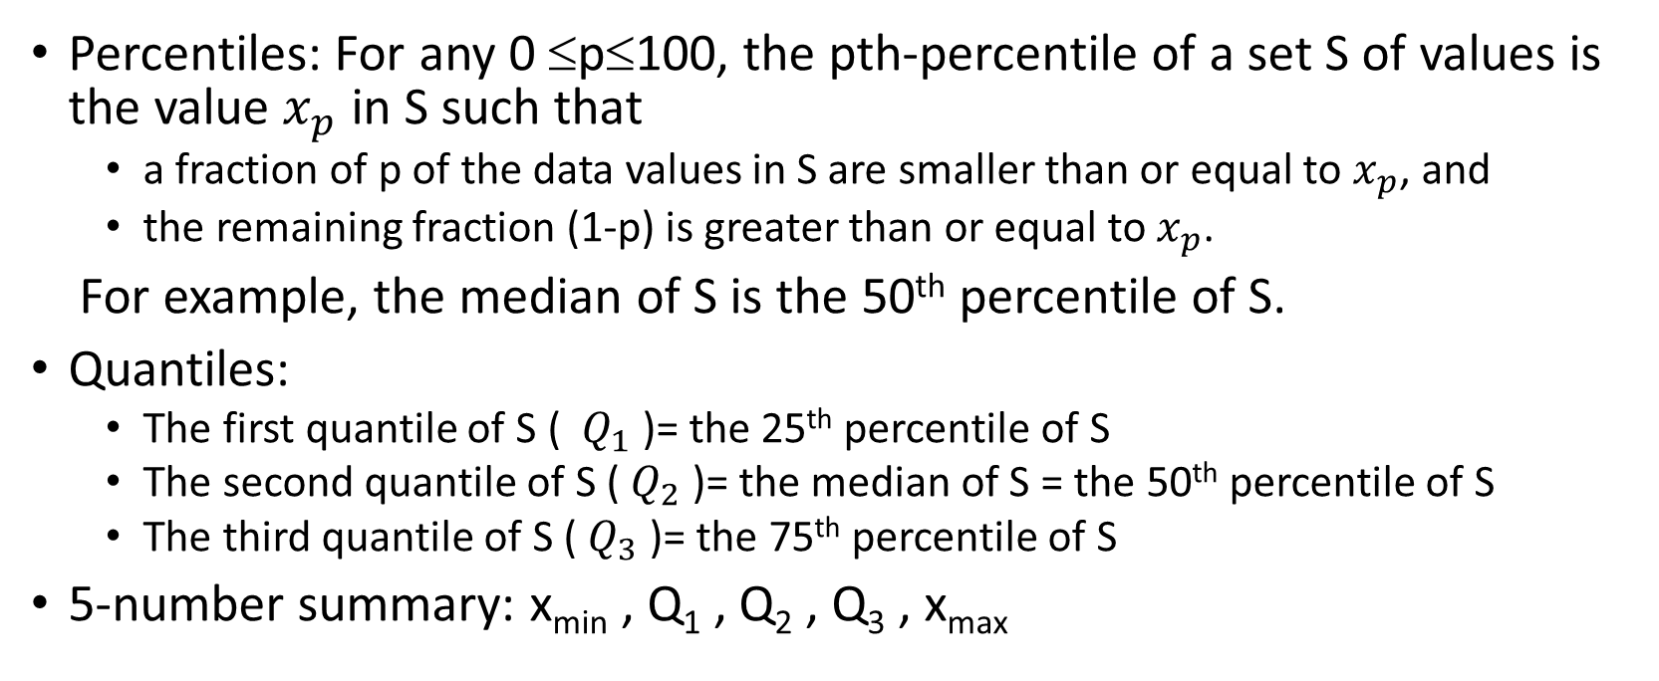


Know your data: detecting outliers
Percentiles: For any 0 ≤p≤100, the pth-percentile of a set S of values is the value $x_{p}$ in S such that
a fraction of p of the data values in S are smaller than or equal to $x_{p}$, and
the remaining fraction (1-p) is greater than or equal to $x_{p}$.
For example, the median of S is the 50th percentile of S.
Quantiles:
The first quantile of S ( $Q_{1}$ )= the 25th percentile of S
The second quantile of S ( $Q_{2}$ )= the median of S = the 50th percentile of S
The third quantile of S ( $Q_{3}$ )= the 75th percentile of S
5-number summary: x_{min} , Q₁ , Q₂ , Q₃ , x_{max}
25%
$$Q_{1}$$
50%
$$Q_{2}$$
75%
$$Q_{3}$$

Slide 31
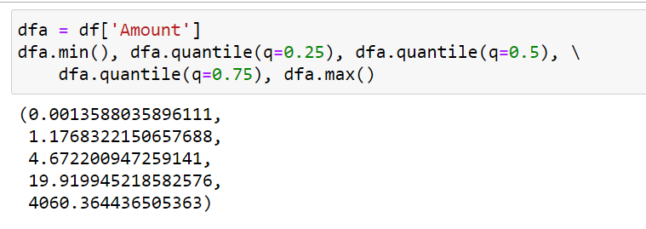

Know your data: detecting outliers
Percentiles: For any 0 ≤p≤100, the pth-percentile of a set S of values is the value $x_{p}$ in S such that
a fraction of p of the data values in S are smaller than or equal to $x_{p}$, and
the remaining fraction (1-p) is greater than $x_{p}$.
For example, the median of S is the 50th percentile of S.
Quantiles:
The first quantile of S ( $Q_{1}$ )= the 25th percentile of S
The second quantile of S ( $Q_{2}$ )= the median of S = the 50th percentile of S
The third quantile of S ( $Q_{3}$ )= the 75th percentile of S
5-number summary: x_{min} , Q₁ , Q₂ , Q₃ , x_{max}
25%
$$Q_{1}$$
50%
$$Q_{2}$$
75%
$$Q_{3}$$

Slide 32
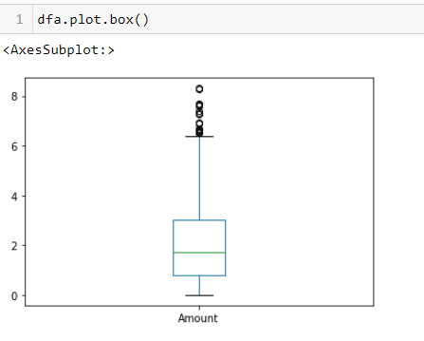
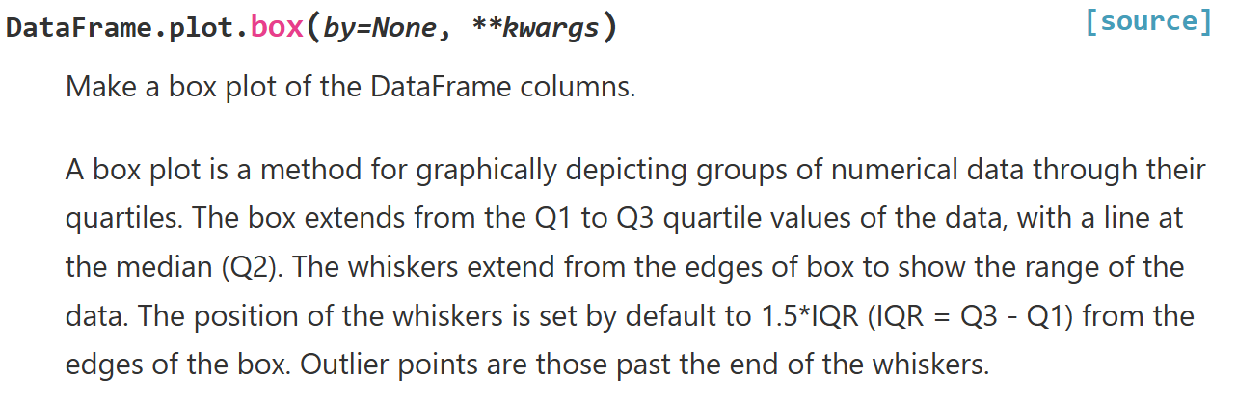
Know your data: detecting outliers

Slide 33
Cleaning your data: detecting outliers
outliers

Slide 34
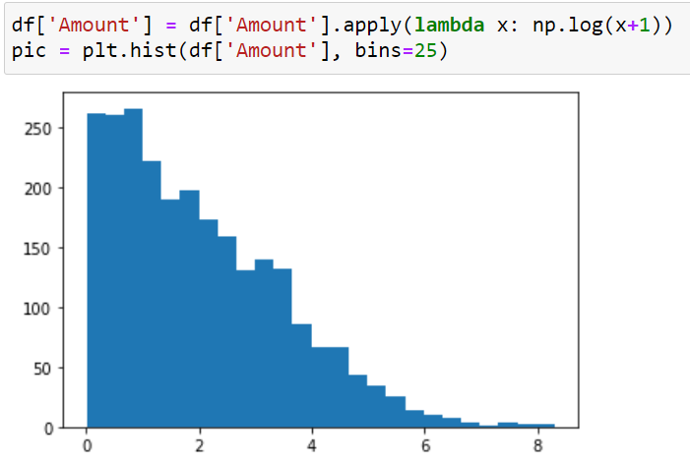
Clean your data: How to deal with outliers
Option 1: Throw them away.
Option 2: Reduce their impact (scaling their values down. Eg. use log-transformation.
ln(4060) = 8.3

Slide 35
Clean your data: How to deal with outliers
Option 1: Throw them away.
Option 2: Reduce their impact (scaling their values down). Eg. use log-transformation.
ln(4060) = 8.3
We don’t select option 1 as outliers are good
candidates for fraud transactions.

Slide 36
Features encoding
In our data set, there are many columns with type “object”. In fact they are character strings. We say that these columns containing categorical data.
Categorical data is a type of data that represents categories or distinct groups rather than numerical values. It is used to classify items or classes based on qualitative characteristics. These categories are often mutually exclusive and do not have a natural order or numerical value associated with them.
In supervised learning, the labels are categorial data.
But ML model learning methods require numeric inputs. Thus, in prepare our dataset, we need to convert (encode) categorical features into a small set of integers (e.g., 0, 1, 2, …, k).

Slide 37
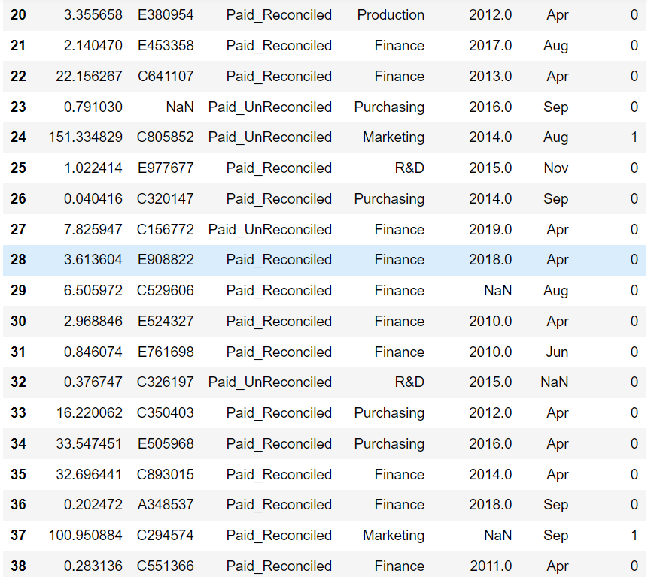
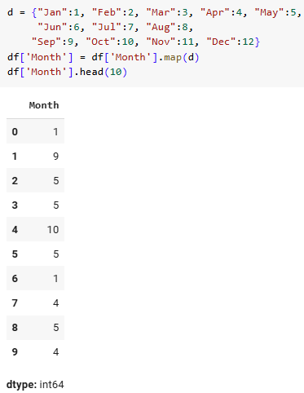
Feature encoding

Slide 38
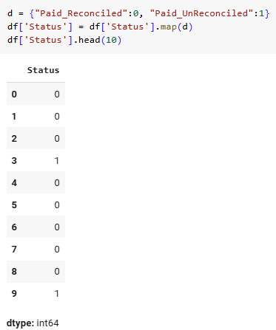
Feature encoding

Slide 39
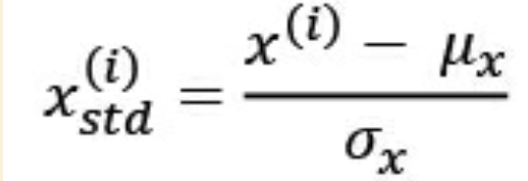
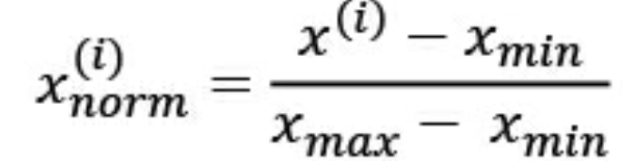
Feature scaling
We also need to do something to the numerical columns.
The majority of ML learning algorithm (e.g. linear regression, SVM, or neural network) behave much better if features are of the same scale.
There are two common approaches to bringing different features onto the same scale:
standardization: where μ_{x} and σ_{x} are the mean and the
standard deviation of of the values in that feature column.
normalization (min-max scaling):

Slide 40
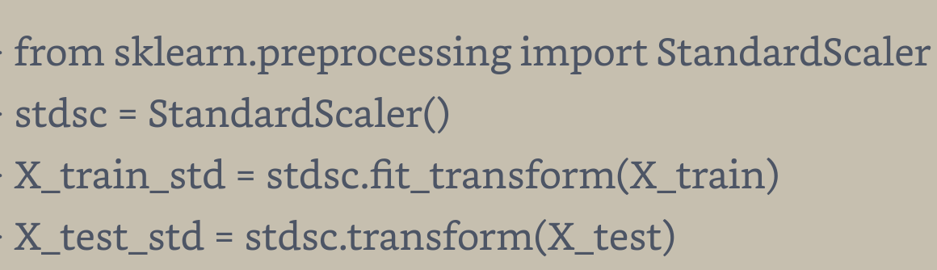
Feature scaling
For standardization:
For normalization: just replace “StandardScaler” by “MinMaxScaler” in the above example.

Slide 41
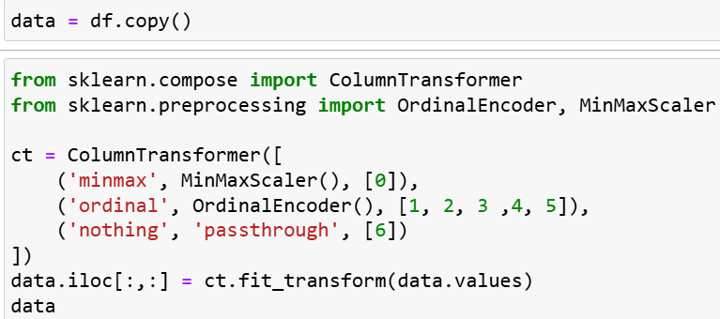
Do Feature encoding and scaling together
Using sklearn’s ColumnTransformer

Slide 42
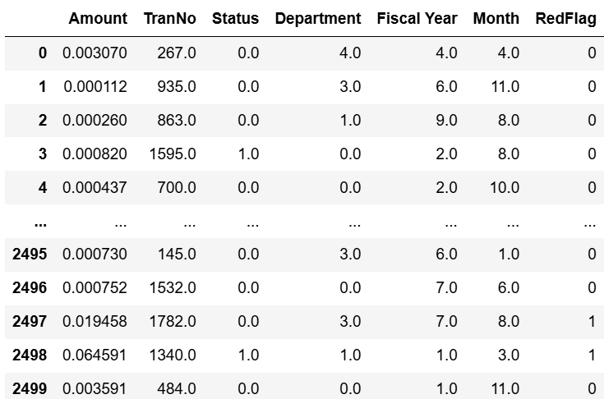
Do Feature encoding and scaling together
Using sklearn’s ColumnTransformer

Slide 43

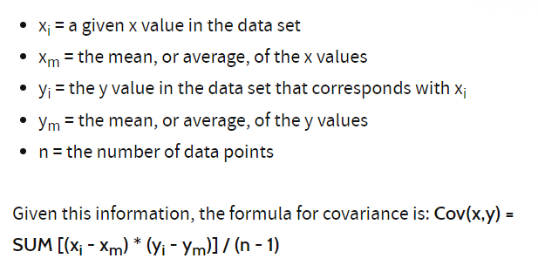
Feature selection
We compute, for each column, the compute the covariance of this column and the output column (i.e., the RedFlag column).
X, Y
Cov(X, X) (aka Variance(X)
Cov(X, Y)
Cov(Y, X)
Cov(Y, Y)
Note: Cov(X,Y) = Cov(Y,X)

Slide 44
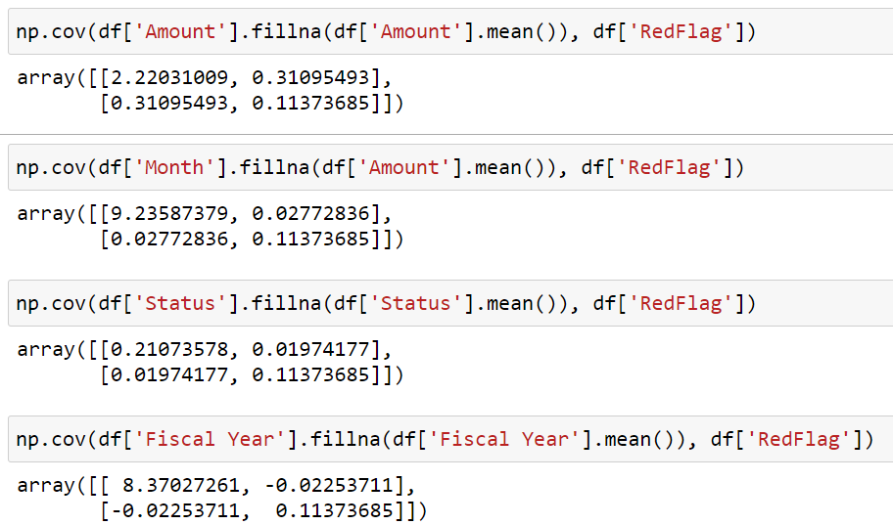
Feature selection

Slide 45
Handle rare classes
It is expected that in our DS, there are only a small fraction of redflag transactions. If we sample the whole DS normally, a major of the training data are non-redflag, and this makes the ML model favor prediction of non-redflag. Thus, in our training dataset, the number of redflag and non-redflag inputs should be more or less equal.
How to do it? By oversamples. E.g. duplicate the redflag inputs in the DS to make the size non-redflag and redflag inputs more or less equal
But we have to do it carefully. There are many good methods.
Navie Random over-sample
ROSE: Random Over-Sample Examples
SMOTE: Synthetic Minority Oversample Technique
ADASYN: Adaptive Synthetic Method

Slide 46
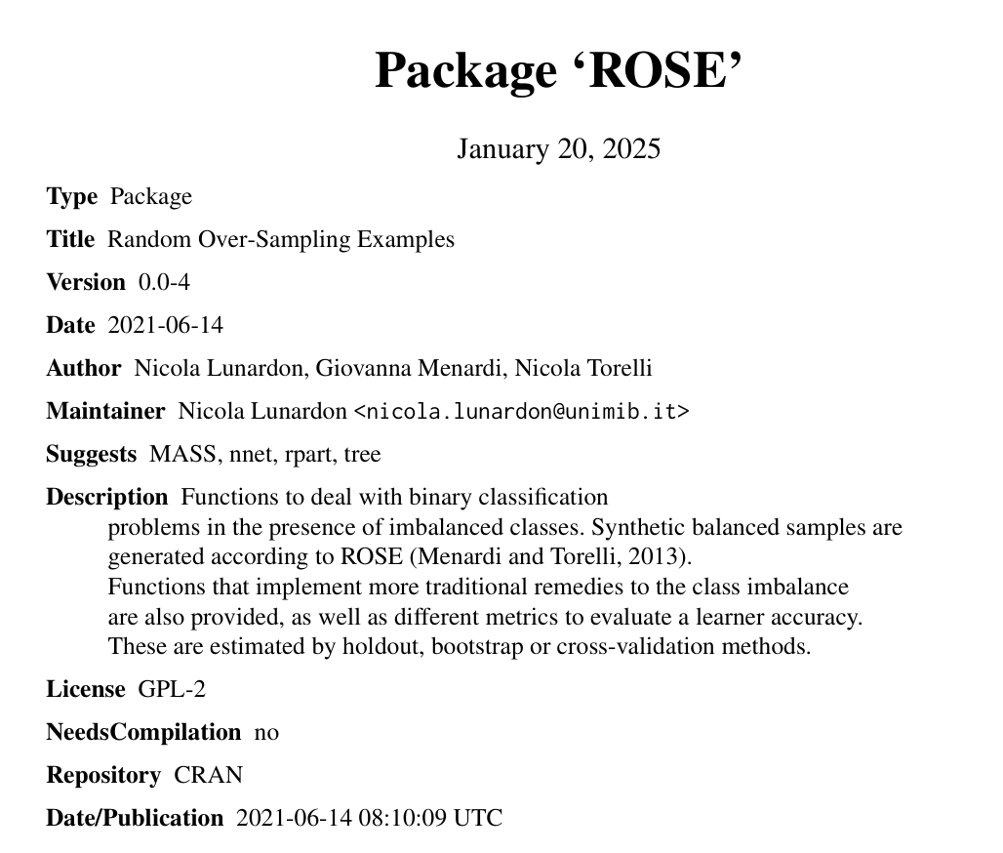
How to handle rare classes
For example,
It is expected that in our DS, there are only a small fraction of redflag transactions. If we sample the whole DS normally, a major of the training data are non-redflag, and this makes the ML model favor prediction of non-redflag. Thus, in our training dataset, the number of redflag and non-redflag inputs should be more or less equal.
How to do it? By oversamples. E.g. duplicate the redflag inputs in the DS to make the size non-redflag and redflag inputs more or less equal
But we have to do it carefully. There are many good methods.
Navie Random over-sample
ROSE: Random Over-Sample Examples
SMOTE: Synthetic Minority Oversample Technique
ADASYN: Adaptive Synthetic Method

Slide 47
We are now ready to apply the ML methods in SciKit-Learn to construct classifiers for detecting fraud transactions

Slide 48
We use the following ML methods from scikit-learn to construct classifiers
GuassianNB: To learn and construct a Guassian Naive Bayes classifier
LogisticRegression: To learn and construct Logistic Regression classifier
DecisionTreeClassifier: To learn and construct a Decision Tree classifier
RandomForestClassifier: To learn and construct a Random Forest classifier
SGDClassifier: To learn and construct a Stochastic Gradient Descent (SGD) classifier

Slide 49
We use the following ML methods from scikit-learn to construct classifiers
GuassianNB: To learn and construct a Guassian Naive Bayes classifier
LogisticRegression: To learn and construct Logistic Regression classifier
DecisionTreeClassifier: To learn and construct a Decision Tree classifier
RandomForestClassifier: To learn and construct a Random Forest classifier
SGDClassifier: To learn and construct a Stochastic Gradient Descent (SGD) classifier

Slide 50
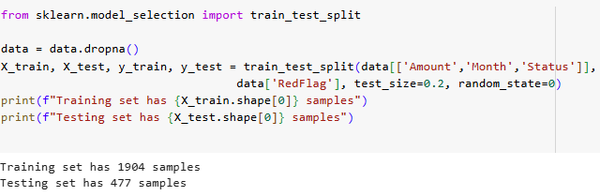
To prepare a test data set for your boss

Slide 51
Preparing an empty table for showing the result

Slide 52
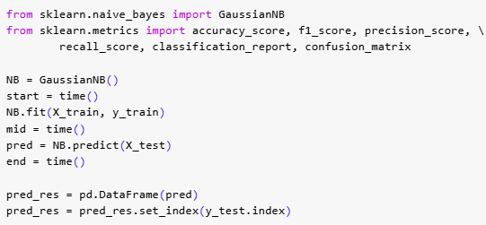
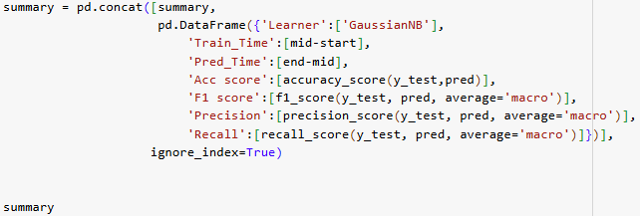


Slide 53
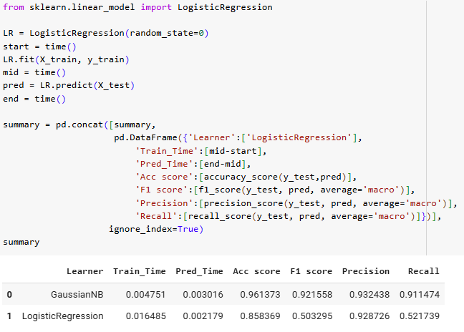

Slide 54
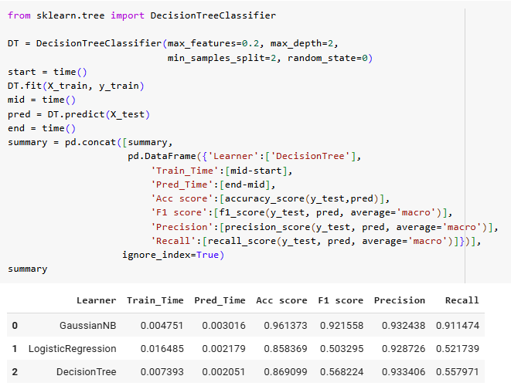

Slide 55
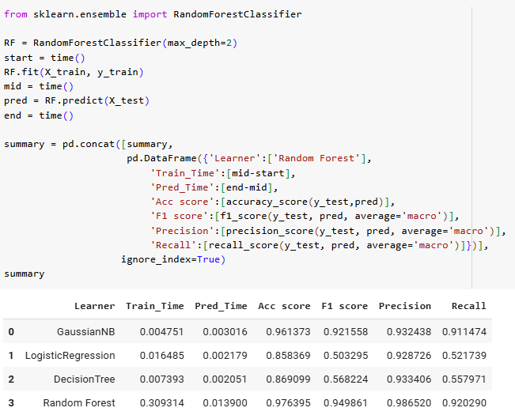

Slide 56
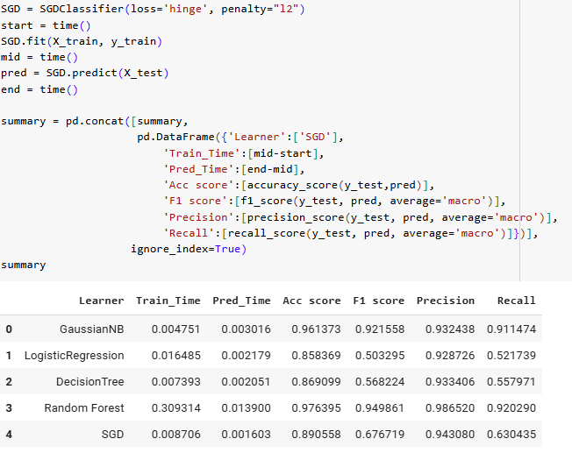

Slide 57
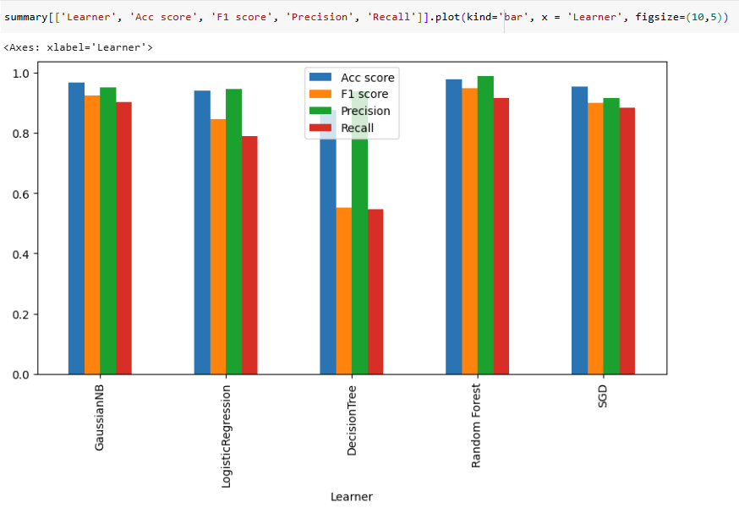

Slide 58
Validation
After training a model using X_train, y_train, we test the model using your boss’ X_test, y_test
But you want to be find out whether your model is not complex (e.g. too many layers in a NN, too many trees in a Random forest), and have good performance for unseen data set, you can divide further divide X_train into two:
X_train:
for training
for testing (validation)

Slide 59
Cross validation
After training a model using X_train, y_train, we test the model using your boss’ X_test, y_test
And to fully use X_train, we may switch the roles of the two data sets:
Round 1:
Round 2:
for training
for testing (validation)
for testing (validation)
for training

Slide 60
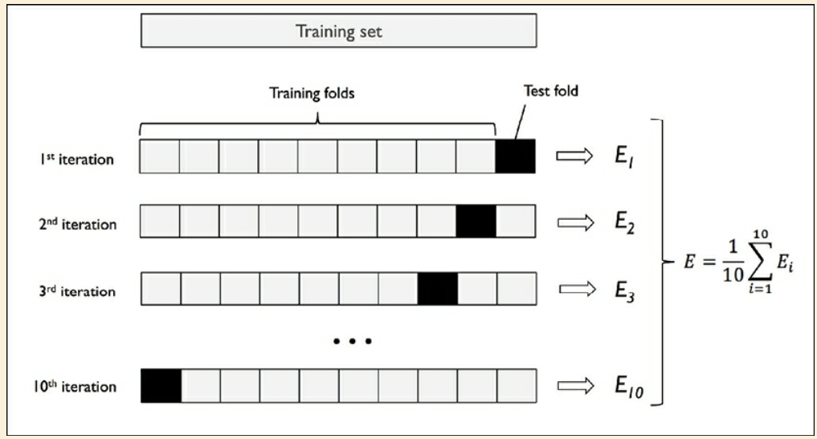
k-fold cross validation
Example: 10-fold validation
validation fold

Slide 61
k-fold cross validation
Example: 10-fold validation
If the average performance of the 10 training sets is poor ➔
model not powerful enough
If the average performance of the 10 training sets is good,
but that of the 10 validation sets is poor ➔
the model has been overfit
If the average performance of both the training sets and
validation sets are good ➔
the model is good
validation fold

